Slide 1
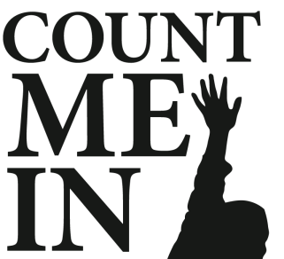
Strategic Framework for Enhancing the Future of Our Public Schools

Slide 2
Who We Are
We are a 27 year old Foundation composed of a 17-member board of directors who guide a budget of just little under $400,000 to aid the CMCSS students and teachers.
Our intention is to help the system deliver better quality results for a more viable workforce and provide greater economic development opportunities.
Our intention is to be partners with the school system to improve the quality of education.

Slide 3
Our Board Members
Brian Taylor, President
Bill Powers, Vice President
Melinda Shepard, Secretary
Tommy Bates, Treasurer
Katie Gambill
Charles Keene
Lori Smith
Stephanie Lobdell
Mark Kelly
Lloyd Matson
Antonio Murgas
Bill Rupp
Marla Rye
Kay Martin
Richard Stevens
Rudy Johnson, Emeritus
Dr. B.J. Worthington, Ex-Officio
Elise Shelton, Ex-Officio
Candy Johnson, Executive Director
Rebecca Dyer, Executive Assistant

Slide 4
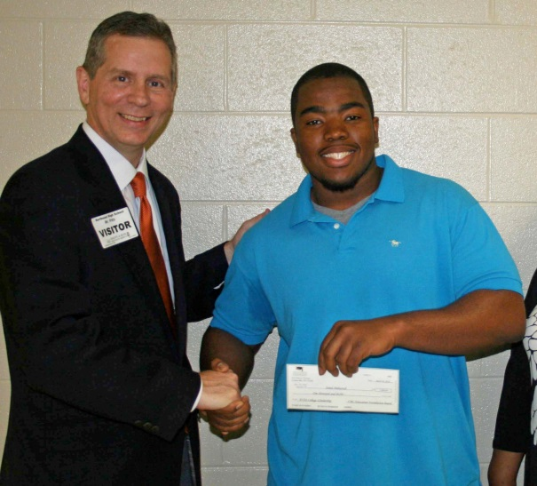
A Quick Look Back
From 2008-2010 our combined assets were $61,398
Funding two major programs: Academic Awards & Scholarships

Slide 5
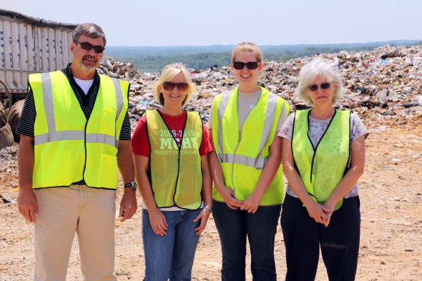
Support to District in 2013-2014
30,786 Lives Impacted by Foundation work
$40,000 in-kind savings to teachers for needed supplies
$387,000 secured to support 8 Foundation programs
$427,000 in support to
Public Education

Slide 6
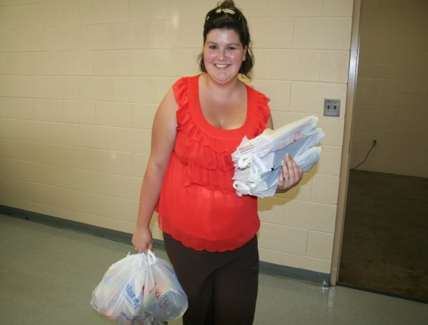
Our Programs
Great Idea Teacher Grants
District Career Academy & STEM Support
Kindergarten Readiness Initiative
100% Graduation (Reality Check & Get Motivated)
Academic Awards Recognition Banquet
Student College Scholarships
CMC Teacher Warehouse Free Supply Store
Pass & Go Advanced Placement
Leadership CMCSS Community Leadership Program
Teacher of the Year Recognition Program

Slide 7
Challenges
27 years of year-to-year fundraising for programs
Less flexibility for innovative programming without additional revenue coming in
More expectations on educators and students
(common core, new graduation requirements, etc.)
Less federal and state funding
Growing need for student and teacher resources

Slide 8
Our Goal
$1 Million Endowed
Our desire is to have a $1M endowment for our Foundation
to foster support of programs increasing student achievement and teacher development.
*Nearly $9,000 in endowment funds growth in one year 2013-2014!!
To date $230,000 pledged to date for Endowment

Slide 9
Already Counted In!!
Batson Nolan PLC | $ 5,000.00
Beach Oil | $ 12,500.00
Bill Powers | $ 1,000.00
Bridgestone Metalpha | $ 2,000.00
Clarksville Pediatric Dentistry | $ 5,000.00
Dominos Pizza | $ 15,000.00
F&M Bank | $ 5,000.00
Home Builders Association | $ 2,455.00
Jack Turner | $ 5,000.00
Legends Bank | $ 15,000.00
Millan Enterprises | $ 5,000.00
Neal Tarpley | $ 5,000.00
Planters Bank | $ 15,000.00
Premier Medical | $ 15,000.00
Rufus Johnson Associates | $ 5,000.00
State Rep. Joe Pitts | $ 5,000.00
The Leaf Chronicle | $ 5,000.00
WBW (Jeff Burkhart) | $ 5,000.00
Wyatt Johnson | $ 2,000.00
APSU College of Business | $ 500.00
Sam's Club Mayor Jim Durrett | $ 5,000.00 $ 2,500.00
In 2012 CMCSS Employees gave collectively $33,000 to CMI

Slide 10
How can you help leave a legacy?

Slide 11
Count Me In Endowment Corporate Giving Commitment Opportunities Pledges can be made over a 4-year period
Education Visionary Circle $100,000 and above
Superintendent Leadership Circle $50,000
Administrator Leadership Circle $25,000
Educator Leadership Circle $15,000
Head of the Class Circle $10,000
Star Student Circle $5,000
Contributor Circle $500-$1,000
**In red-average gift to date

Slide 12
Your Gifts Will
Help sustain the future of Foundation programs for students and teachers
Fund other innovative efforts in schools that traditional tax dollar funding does not support
Support the expansion of future High School Career Academies & STEM efforts
Create more opportunities for funding through grant matching for CMCSS
More scholarships for CMCSS students & Classroom Grants for CMCSS teachers
Cover foundation operating costs to keep up with growth in years of need
Be invested wisely, using only interest, while securing principle for the future
Support economic development by preparing a better workforce for our community

Slide 13
Count Me In Perks…WIIFM?
All gifts will be recognized on the CMC Education Foundation website, printed materials for foundation events, annual report and other media related opportunities presented during the year.
All donors investing in the “Count Me In” endowment campaign will receive exclusive updates and events relating to the state of public education and invited to join in special discussions.
All gifts of $5,000 and above will be displayed in a designated Central Office area on a special recognition plaque. Other media and recognition will be given at Foundation Events. In addition, a Foundation “Count Me In” award will be placed in that organization’s office to display their support of Public Education.
All gifts of $25,000 and above grant a company representative the opportunity to serve as an advisory Education Foundation board member over the next 4 years and possible naming rights of a future program.
For more information about “Count Me In” or additional planned giving options please contact the Foundation office at 931-920-7955. Central Administrative Offices/Education Foundation, 621 Gracey Avenue, Clarksville, TN 37040.
www.cmcss.net/educationfoundation

